Slide 1

React Essential Features and Syntax
Lesson 02
Notes:
Add instructor notes here.

Slide 2
Lesson Objectives
At the end of this module you will
be able to:
React App Project Directory Structure
Overview of Webpack, Babel
React Component Basic
Create React Component
Understanding JSX
Limitations of JSX
Working with Components and Reusing Components
Notes:
Add instructor notes here.

Slide 3
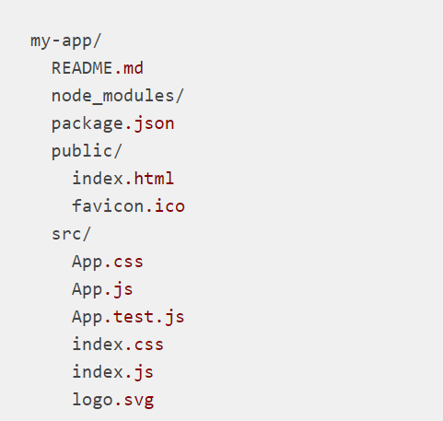
React App Project Directory Structure
Folder Structure :
After creation, your project should look like this:
Notes:
For the project to build, these files must exist with exact filenames:
public/index.html is the page template;
src/index.js is the JavaScript entry point.
You can delete or rename the other files.
Slide explains that communication between service provider and consumer happen via SOAP messages

Slide 4
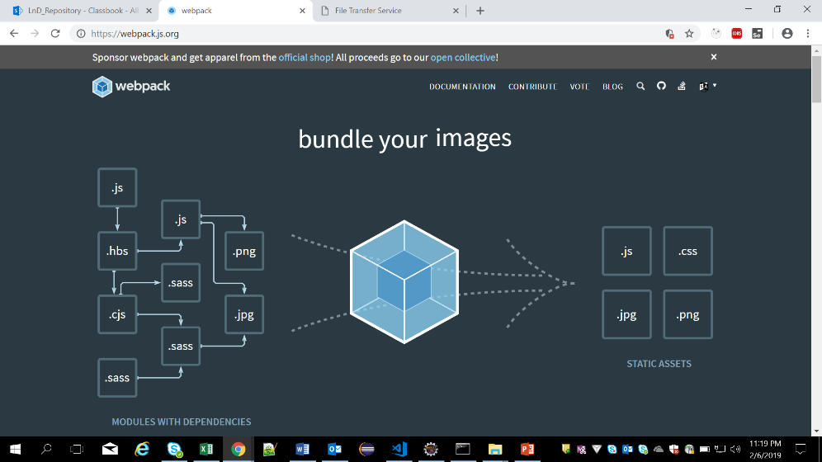
Overview of Webpack, Babel
Webpack :
webpack is a static module bundler for modern JavaScript applications.
Extended to support many different assets such as images, fonts and stylesheets.
Babel :
Babel is a JavaScript compiler
Babel is a toolchain that is mainly used to convert ECMAScript 2015+ code into a backwards compatible version of JavaScript in current and older browsers or environments.
Notes:
webpack cares about performance and load times; it's always improving or adding new features, such as async chunk loading and prefetching, to deliver the best possible experience for your project and your users.
Why webpack
To understand why you should use webpack let's recap how we used JavaScript on the web before bundlers were a thing.
There are two ways to run JavaScript in a browser. First, include a script for each functionality; this solution is hard to scale because loading too many scripts can cause a network bottleneck. The second option is to use a big .js file containing all your project code, but this leads to problems in scope, size, readability and maintainability.
Here are the main things Babel can do for you:
Transform syntax
Polyfill features that are missing in your target environment (through @babel/polyfill)
Source code transformations (codemods)
The slide explains in brief, the components which make up the web service

Slide 5
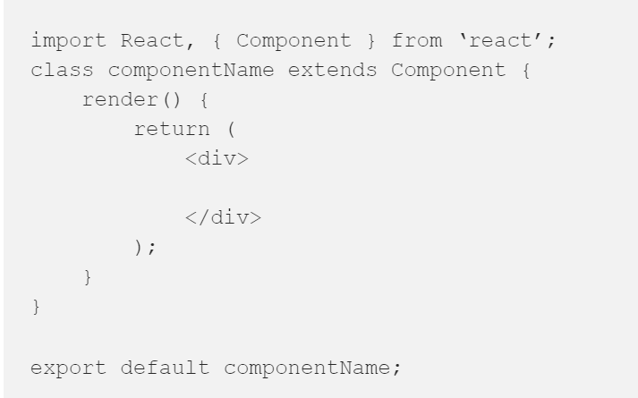
React Component Basic
Components:
Components let you split the UI into independent, reusable pieces,
and think about each piece in isolation.
Conceptually, components are like JavaScript functions.
Every component follows this basic structure:
Notes:
every React component is a class. This class extends the Component class from the react module, and as we said before, we need to import React from react in order to get our component to work. Inside the render() method, we are going to return only one element, it’s common that we wrap everything with a big <div>. Inside the component file we can define several classes, but we specify which one is going to be exported as default with the last line. I just added some information to my TestComponent, and style with some CSS:
function Welcome(props) {
return <h1>Hello, {props.name
}</h1>;
}
You can also use an ES6 class to define a component:
class Welcome extends React.Component { render() { return <h1>Hello, {this.props.name}</h1>; } }
Slide explains about WSDL and UDDI registry.
Also explains regarding web service communication

Slide 6
Create React Component
We can Create a new React Project using the create-react-app command.
Install create-react-app using npm by using below command
npm i create-react-app
Then you create your own component and react app by using below command
create-react-app my-app
Notes:
Add instructor notes here.

Slide 7
JSX (JavaScript and XML)
is JavaScript syntax extension which looks similar to XML
looks like HTML but is actually a mix of JavaScript and HTML.
Asdvantages of JSX:
It's easier & faster to write JSX, compared to JavaScript.
JSX code ensures readability & Maintainability.
JSX finds most of the errors at compilation time, which makes it faster
Comparatively to JavaScript
var grp = <div>
<p>Welcome to TutsPlus</p>
</div>;
Babel would transform the above JSX code to the required react function as shown:
var grp = React.createElement( "div", null, React.createElement(
"p", null, "Welcome to TutsPlus" ) );
Notes:
Babel is nothing but Transpiler,
Babel can convert JSX syntax and strip out type annotations.

Slide 8
Limitations of JSX:
complexity
consequent steep learning curve

Slide 9
Working with Components and Reusing Components
React lets you define components as classes or functions.
To define a React component class, it must extend React.Component
Reusable Components
When designing interfaces, break down the common design elements (buttons, form fields, layout components, etc.) into reusable components with well-defined interfaces.
That way, the next time you need to build some UI, we can write much less code.
This means faster development time, fewer bugs, and fewer bytes down the wire.
class Welcome extends React.Component {
render() {
return <h1>Hello, Welcome</h1>;
}
}
Notes:
Reusable components are like in above slide Welcome is a reusable component
class Greeting extends React.Component { render(){ return <h1>Hi, I’m a smart component!</h1>; } }
In above code greetings is a reusable

Slide 10
Summary
React App Project Directory Structure
Overview of Webpack, Babel
React Component Basic
Create React Component
Understanding JSX
Limitations of JSX
Working with Components and Reusing Components
Notes:
Add the notes here.
Add instructor notes here.

Slide 11
review
1. JSX is a shorthand for
A) Javasctipt & XML
B) XML and java
C) Javascript & Java
D) HTML & Javascript
2. To Enable a browser to read JSX, first, we need to transform JSX file into a JavaScript object using JSX transformers like?
A) Babel
B) Babel Transformer
C) Gulp
D) React Compiler
3. Search and identify why React Js is faster than other UI Frameworks

